Slide 1
Goal-Based Software Measurement Framework
Chapter 3

Slide 2
Goal-Based Measurement (GBM)
The primary question in goal-based measurement:
“What do we want to know or learn?”
instead of “What metrics should we use?”
Because the answers depend on your goals, no fixed set of metrics is universally appropriate.
Instead of attempting to develop general-purpose measures, one has to describe an adaptable process that users can use to identify and define measures that provide insights into their own development problem.

Slide 3
GBM Process
Determining what to measure
Identifying entities
Classifying entries to be examined
Determining relevant goals
Determining how to measure
Inquire about metrics
Assign metrics

Slide 4
Identifying Entities
Process
A collection of software related activities.
Product
Any artifacts, deliverables or documents that result from a process activity.
Resource
Entities required by a process activity.

Slide 5
Process, Product, Resource
Process
process activities have duration
they may be ordered or related in some way that depends on time.
different SE processes: development, maintenance, testing etc.
Product
Each process activity uses resources and produces products.
The product of one activity may feed another activity.
a design document can be the product of the design activity, which is then used as an input to the coding activity.
Resource
People (designer, programmer, tester etc.), reusable software components, hardware/software tools

Slide 6
Types of Attributes
Internal attributes
Attributes that can be measured entirely in terms of the process, product or resource itself without considering its behavior. (size)
External attributes
Attributes that can be measured with respect to how the process, product or resource relates to its environment through its behavior. (quality)
Example:
consider a set of software modules
internal attributes: its size (perhaps in terms of lines of code, LOC or number of operands), its complexity (perhaps in terms of the number of decision points in the code), and the dependencies among modules.
external attributes: the number of failures experienced by the user, the difficulty that the user has in navigating among the screens provided, or the length of time it takes to search the database and retrieve requested information.

Slide 7
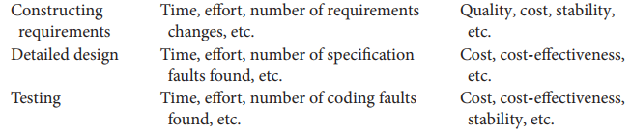
Example of Attributes
Process
Entity Internal External

Slide 8
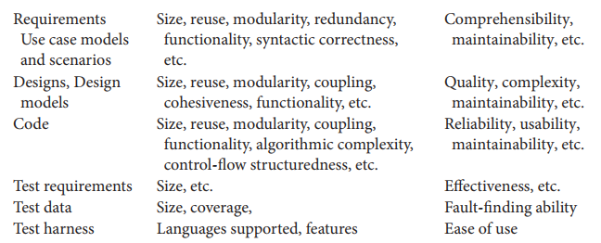
Example of Attributes
Product
Entity Internal External

Slide 9
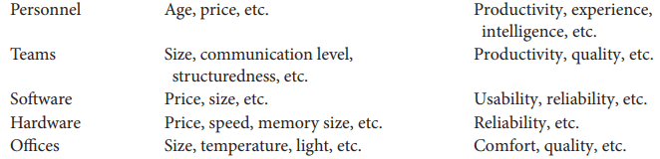
Example of Attributes
Resources
Entity Internal External

Slide 10
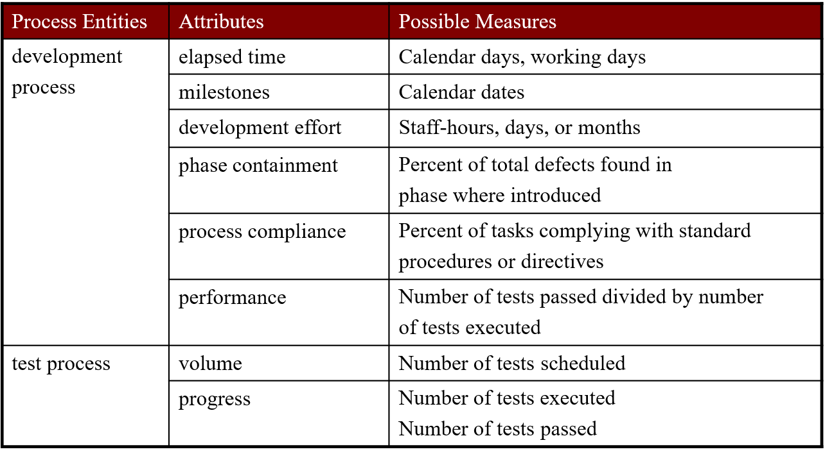
Attributes with possible measures

Slide 11
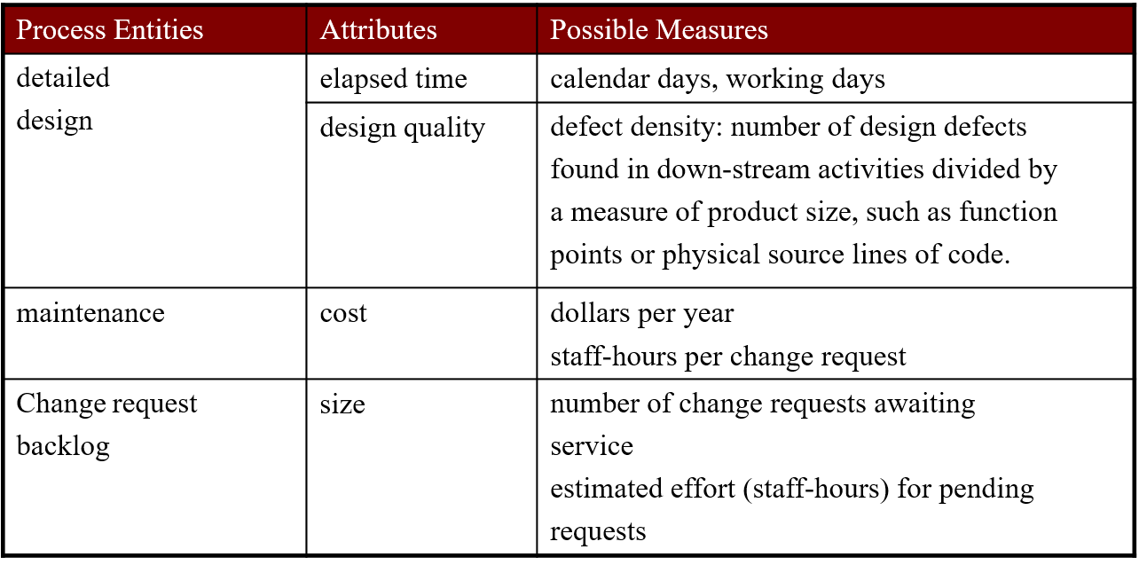
Attributes with possible measures

Slide 12
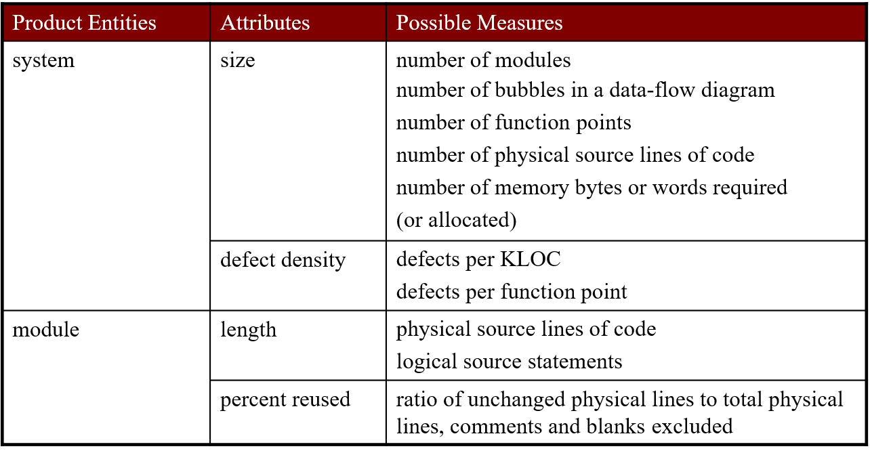
Attributes with possible measures

Slide 13
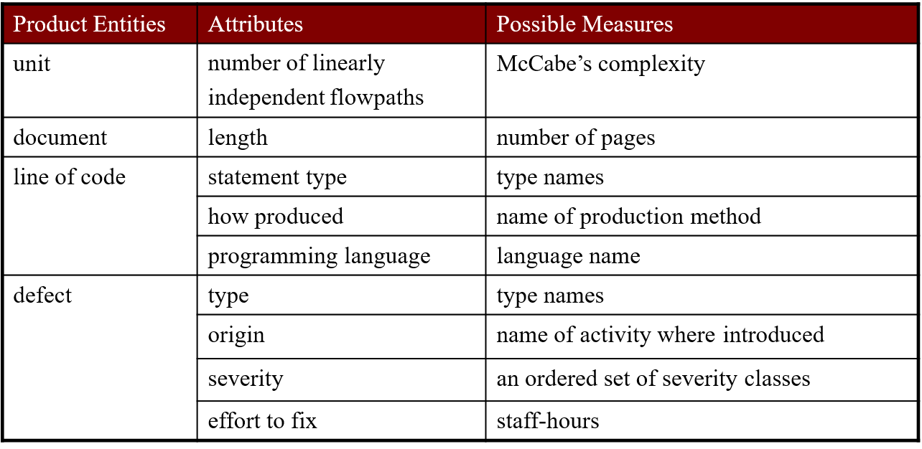
Attributes with possible measures

Slide 14
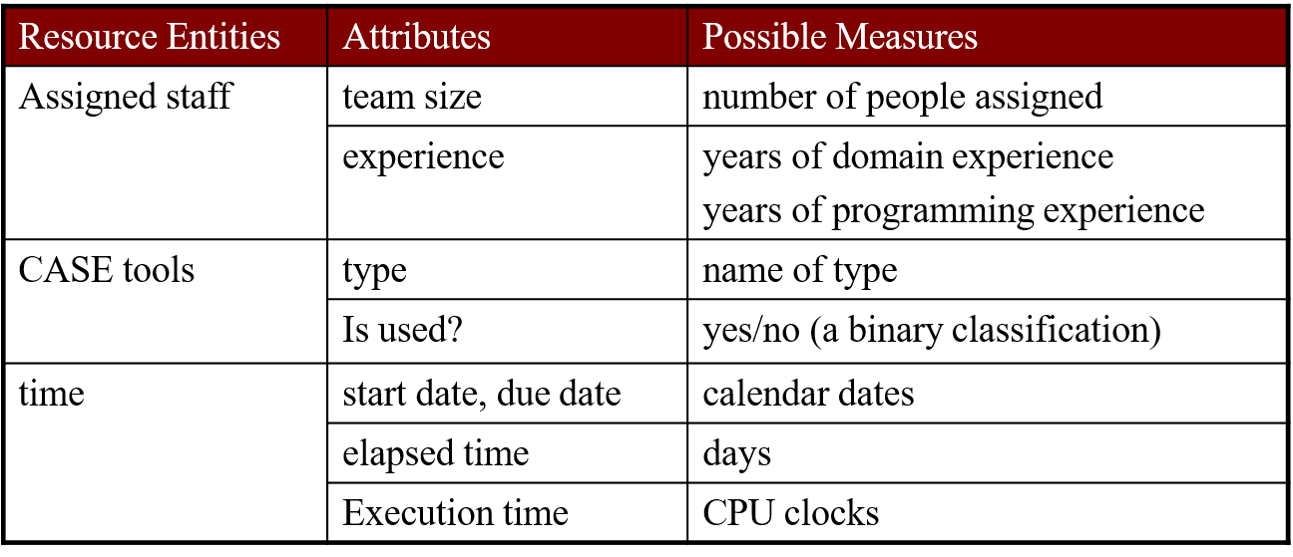
Attributes with possible measures

Slide 15
DETERMINING WHAT TO MEASURE
Measurement is useful only if it helps you to understand an underlying process or one of its resultant products.
It depends on your objectives—you select specific measurements based on what information you need to meet your goals.
The Goal-Question-Metric approach (GQM) for metrics selection, first suggested by Basili and his colleagues. [Basili and Weiss 1984]
Notes:
To use GQM,
First identify the overall goals of your organization (corporation, individual department or lab)
Second, generate questions whose answers you must know in order to determine whether your goals are being met.
Finally, analyze each question to identify measurements you need in order to answer each question.

Slide 16
GQM Approach
Goal-Question-Metric (GQM) approach to process metrics provides a framework for deriving measures from organization or business goals.
The goal provides the purpose for collecting the data, and the questions tell you and your project how to use the data.
The GQM approach provides a framework involving three steps: 1. List the major goals of the development or maintenance project. 2. Derive from each goal the questions that must be answered to determine whether the goals are being met. 3. Decide what must be measured in order to be able to answer the questions adequately.

Slide 17
GQM Approach
Phase | Description
1 | Developing a set of corporate, division and project goals
2 | Generating questions that define those goals as completely as possible in a quantifiable way
3 | Specifying measures (metrics) needed to be collected to answer those questions and to track process and product conformance to the goals
4 | Developing mechanisms for data collection
5 | Collecting, validating and analyzing the data in real time to provide feedback to projects for corrective action, to assess conformance to the goals and make recommendations for future improvements

Slide 18
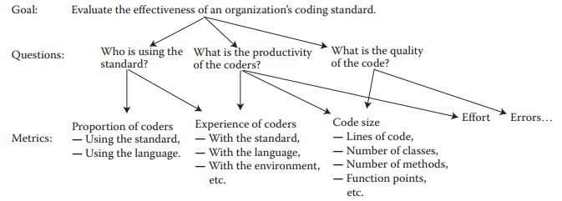
GQM Approach Example
Notes:
https://www.geeksforgeeks.org/coding-standards-and-guidelines/

Slide 19
GQM Approach Example 2
You are manager for a software development team and you have to decide upon the release time of your product. Construct a GQM tree related to this goal.
Size of code
What is reliability requirement?
Number of failures discovered
Number of test cases
Goal: suitable Release time
What is current reliability?
Hours of use
Number of person days Available for testing
What are time constraints?
Days till deadline

